Slide 1
INFORMATION TECHNOLOGY
Submitted by – Amrita Majumdar
Student of Anudip Foundation

Slide 2
Table of Contents :
Introduction to IT and Business Systems
Data Types , Sources and Life cycle
Introduction to Business Analyst Role
Data vs. Information
Overview of Data Driven Decision Making
Case Discussions / Real-Life Examples
Introduction to Data Governance & Data Ethics
Conclusion

Slide 3

Introduction to IT and Business Systems
A concise, student-friendly guide to the fundamentals of Information Technology (IT), common business systems, and how technology shapes business strategy. This deck explains core concepts with clear definitions, beginner-level examples, and visuals that help connect ideas.

Slide 4
What is Information Technology (IT)?
Definition
Everyday Examples
IT = hardware + software + networks used to collect, process, store, and deliver information. It enables organizations to operate, communicate, and make data-driven decisions.
Computers, smartphones, Wi‑Fi, cloud storage, email systems, and collaboration tools like Microsoft Teams or Google Workspace.
Why It Matters
IT speeds up processes, improves access to information, and reduces manual work — making organizations more efficient and responsive.

Slide 5




Fundamentals of Information Technology
Hardware
Data
Physical devices: servers, desktops, laptops, routers, switches, and storage devices that form the infrastructure.
Raw facts that are collected, stored,
and analyzed to produce reports and
insights used in decision-making.
Software
People & Procedures
Applications and operating systems that run tasks — from productivity apps to enterprise software and mobile apps.
Users, IT professionals, and documented
processes (policies, security rules, troubleshooting guides) that govern how technology is used.
Short definition: The four pillars of IT are Hardware, Software, Data, and People &
Procedures — each must work together for reliable systems.

Slide 6
Role of IT in Business Operations
Automation
Automates routine tasks such as payroll processing, invoice generation, and inventory updates — saving time and reducing human error.
Communication & Collaboration
Email, messaging, video conferencing, and shared workspaces enable teams to collaborate across locations in real time.
Decision Support
Real-time dashboards and analytics provide actionable insights for managers — supporting faster, more informed decisions.
Operational Example
Walmart’s RetailLink: a supplier-to-store system that shares inventory and sales data to speed restocking and reduce shortages.

Slide 7
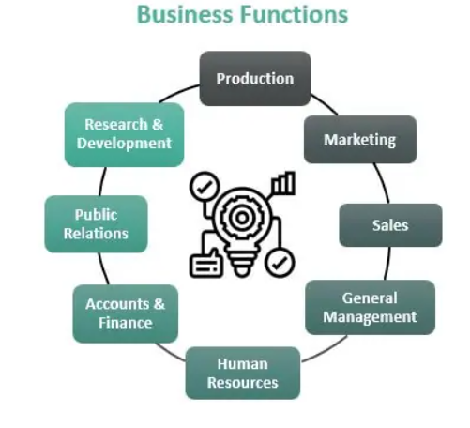
What Are Business Systems?
Definition
Business systems are software solutions specifically designed to support and automate key business functions, integrate data, and streamline processes across teams and departments.
Core Types
ERP (Enterprise Resource Planning) and CRM (Customer Relationship Management) are two foundational systems used by most medium-to-large organizations.

Slide 8

ERP (Enterprise Resource Planning) — Overview & Example
SAP ERP: Real-world Example
SAP is used by large firms (e.g., Coca-Cola) to connect finance, manufacturing, procurement, inventory, and HR into a unified system — enabling global consistency and reporting.
Key Benefits
Integrated data across departments
Faster month-end and operational reporting
Reduced duplicate entry and fewer reconciliation errors
Beginner-Friendly View
Think of ERP as the company’s central nervous system: it shares information between finance, operations, and HR so everyone works from the same data.

Slide 9
CRM (Customer Relationship Management) — Overview & Example
Salesforce: Real-world Example
Salesforce centralizes customer interactions, sales opportunities, and marketing campaigns. Brands like Adidas use it to track customer preferences and personalize outreach.
Key Benefits
Improved customer service with consolidated records
Targeted marketing based on customer data
Clear sales pipeline visibility to boost conversions
Simple Definition
CRM = a digital rolodex + sales and marketing tools that help companies manage interactions and build long-term customer relationships.

Slide 10
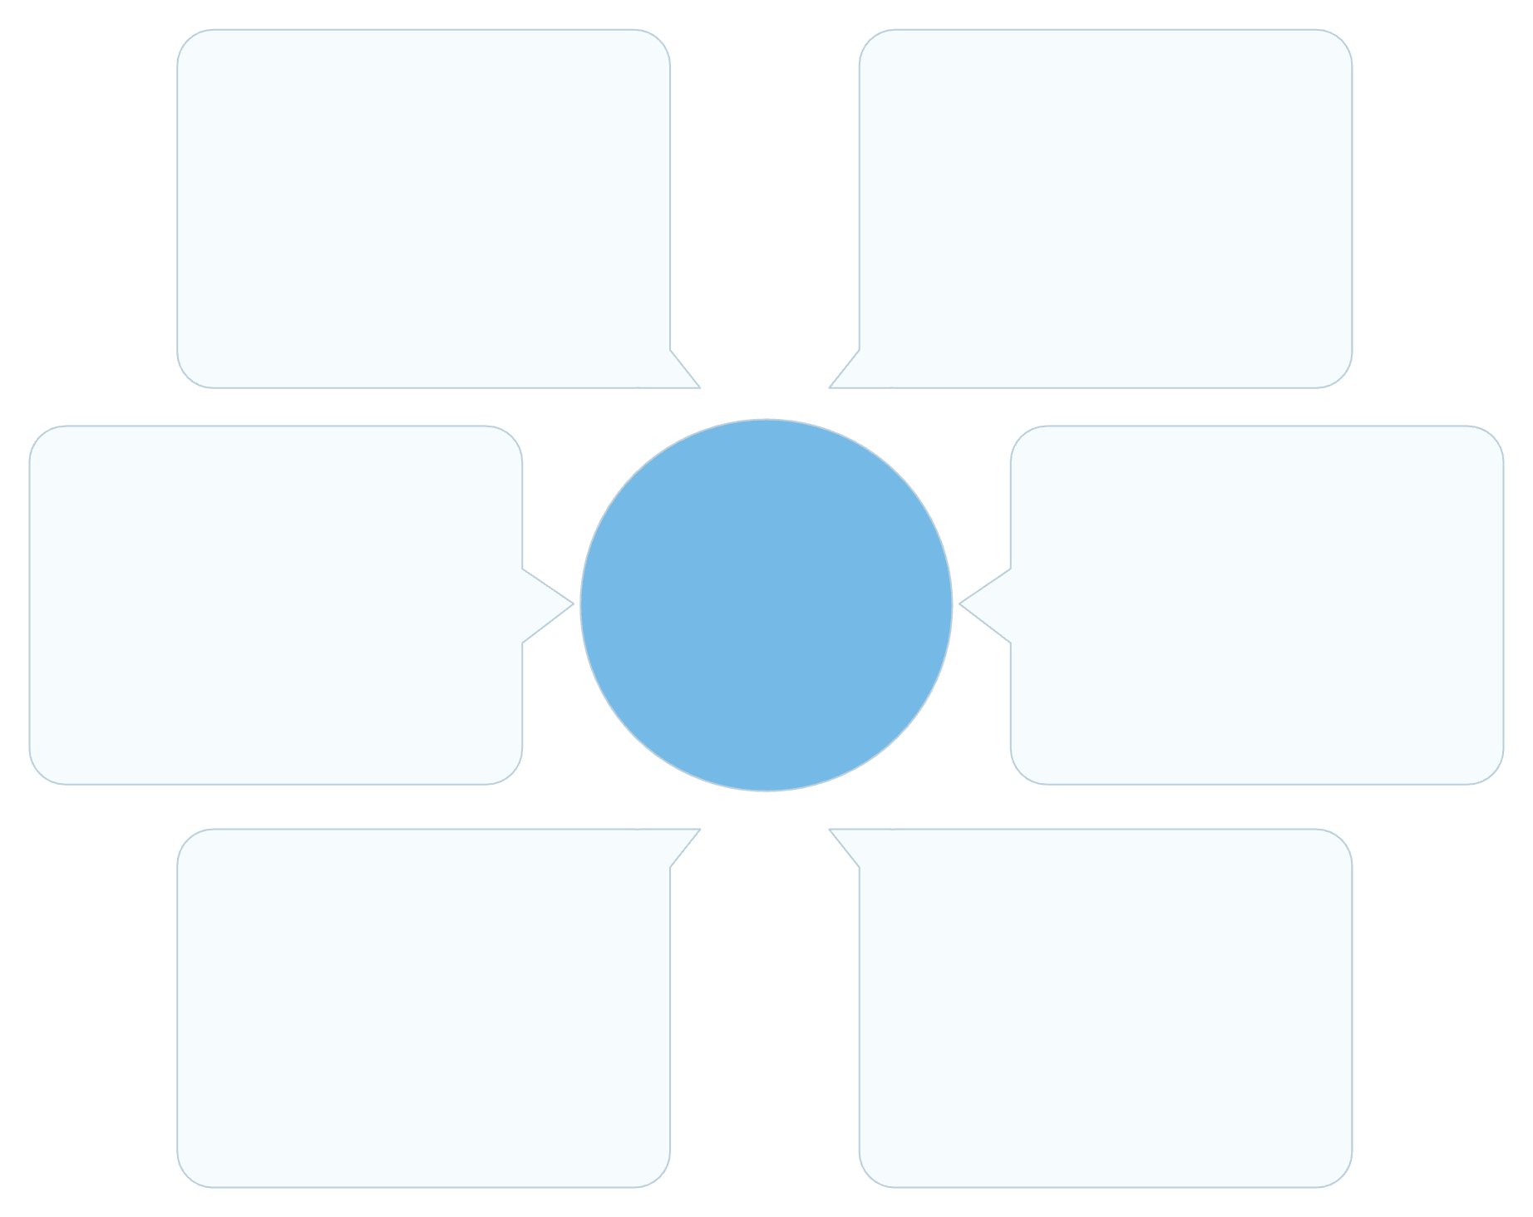
How IT Supports Business Strategy
Innovation
Robust infrastructure
New products and business models
Reliable platforms and networks
Customer intimacy
How IT Supports Strategy
Trusted data
Personalized experiences and loyalty
Accurate analytics and insights
Operational excellence
Flexible applications
Streamlined processes and cost reduction
Scalable, user-focused software
Strategic Roles of IT
Real Example
Operational Excellence — streamline processes and reduce costs
Customer Intimacy — personalize experiences and improve retention
Innovation — enable new products, services, and business models
Netflix uses sophisticated IT (data pipelines, recommendation algorithms, cloud infrastructure) to deliver personalized content, retain customers, and expand into new markets.

Slide 11

Interplay Between IT and Business Strategy
Mutual Influence
Strategy defines which IT investments are prioritized (e.g., customer-focused vs cost-focused), while IT capabilities expand what strategic options are possible.
Investment Decisions
Choosing between build vs buy, cloud vs on-premises, and data analytics platforms should align with long-term strategy and risk tolerance.
Organizational Impact
Digital firms design organizational structures and processes around technology — leading to faster decision cycles and more flexible operations.

Slide 12

Data Types, Sources, & Lifecycle
A foundational guide for aspiring data professionals

Slide 13
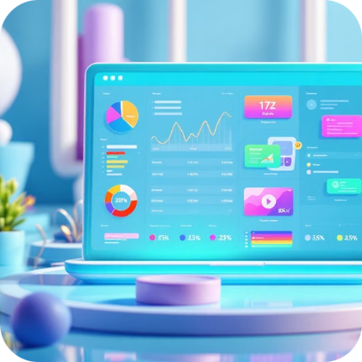


Understanding Data Types
Data comes in many forms, each with unique characteristics and optimal handling methods. Recognizing these types is crucial for effective data management.
Structured Data
Unstructured Data
Semi-Structured Data
Highly organized data that fits into a fixed field within a record or file. Think of traditional relational databases where information is stored in tables with predefined schemas.
Data that does not have a predefined data model or is not organized in a predefined manner. It makes up the vast majority of data generated today.
A form of structured data that does not conform to the formal structure of relational databases but contains tags or markers to separate semantic elements and enforce hierarchies.
Easy to store and query
Examples: Customer names in a CRM, transaction dates in an ERP system
Harder to analyze directly
Examples: Emails, social media posts, audio files, videos, PDF documents
More flexible than structured, easier to process than unstructured
Examples: JSON, XML files, NoSQL databases, sensor data

Slide 14
Common Data Sources
Data can originate from diverse locations, influencing its reliability, format, and accessibility.
Knowing your sources is key to robust analysis.
Internal Sources
External Sources
Data generated within an organization, often from daily operations and business processes.
Data originating outside the organization, often providing market insights, competitive intelligence, or broad contextual information.
Public datasets (government statistics, research)
Social media feeds (trends, public sentiment)
Third-party market research reports
Weather data, stock prices
CRM systems (customer data)
ERP systems (financial, operational data)
Log files (server activity, application performance)
Employee records, sales figures
Databases
APIs (Application Programming Interfaces)
Organized collections of data, serving as a primary storage and retrieval mechanism for both internal and external data.
Interfaces that allow different software applications to communicate and exchange data, often used to access external data sources programmatically.
Relational Databases (SQL): MySQL, PostgreSQL, Oracle
NoSQL Databases: MongoDB, Cassandra, Redis
Data Warehouses: Optimized for complex query and analysis
Google Maps API (location data)
Social media APIs (Twitter, Facebook data)
Payment gateway APIs (transaction data)

Slide 15
Diverse Data Collection Methods
Collecting data effectively requires choosing the right methods to ensure accuracy and
relevance for your analytical goals.
Surveys & Questionnaires
Web Scraping
Directly asking individuals for information using structured questions. Ideal for gathering opinions, preferences, and demographic data.
Automated extraction of data from websites. Useful for gathering large volumes of publicly available information like product prices or news articles.
Online forms, interviews, phone surveys
Quantitative and qualitative insights
Requires ethical considerations and adherence to website terms
Tools: BeautifulSoup, Scrapy

Slide 16

Sensor Data
Transactional Systems
Automatic collection of data from physical devices equipped with sensors. Common in IoT (Internet of Things) applications.
Data generated from everyday business transactions. This includes purchases, bookings, service requests, and financial exchanges.
Temperature sensors, motion detectors, GPS devices
Real-time monitoring and analytics
Point-of-sale (POS) systems
E-commerce platforms
Banking systems

Slide 17
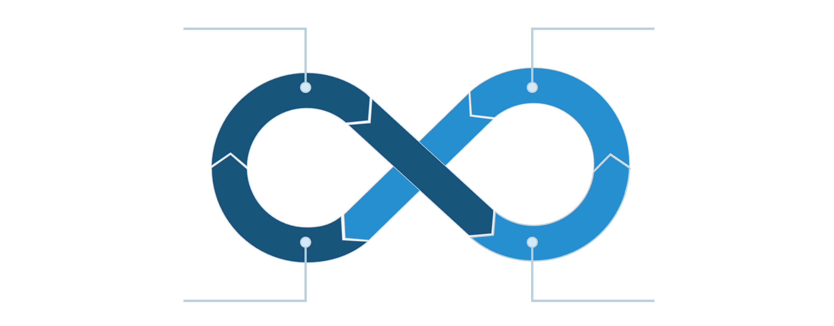
Data Lifecycle Management
The data lifecycle defines the stages a piece of data goes through from its inception to its eventual deletion.
Managing this lifecycle ensures data is secure, accessible, and useful.
Create Data
Store Securely
Archive & Delete
Use & Analyze
Effective data lifecycle management ensures data compliance, reduces storage costs, and maximizes the value
of information throughout its entire existence.

Slide 18
Stages of the Data Lifecycle
01
02
03
1. Creation/Capture
2. Storage & Maintenance
3. Usage & Processing
Data is generated or collected for the first time. This includes direct input, sensor readings, or data derived from other sources.
Data is stored in appropriate systems and regularly maintained to ensure its availability and integrity.
Data is accessed, processed,
analyzed, and transformed to
derive insights and support
decision-making.
Data entry forms
Web analytics tools
IoT device telemetry
Databases, data warehouses, cloud storage
Backup, security, and access control
Reporting, dashboards,
machine learning models
Data transformation and
integration
04
05
4. Archiving
5. Deletion/Destruction
Data that is no longer actively used but may be needed for compliance, historical analysis, or future reference is moved to long-term, cost-effective storage.
Data is permanently removed from all storage
systems when it's no longer needed or legally required, ensuring privacy and minimizing liabilities.
Reduced access frequency
Compliance with retention policies
Secure data erasure
Adherence to privacy regulations (e.g., GDPR)

Slide 19
Data Quality and Integrity :
High-quality data is the bedrock of reliable analysis and trustworthy insights. Data integrity ensures that data remains accurate and consistent over its entire lifecycle.
Introduction to Data Quality & Integrity
Data Quality refers to the accuracy and reliability of data
Data Integrity ensures data remains correct and consistent over time
High-quality data improves decision-making
Important in business, banking, healthcare, and IT systems
Poor data quality can lead to wrong decisions and losses

Slide 20






Key Dimensions of Data Quality
Ensuring Data Integrity
Accuracy: Is the data correct and reflective of reality?
Completeness: Is all necessary data present? Are there missing values?
Consistency: Is data uniform across all systems and formats?
Timeliness: Is the data up-to-date and available when needed?
Validity: Does the data conform to defined business rules and formats?
Uniqueness: Are there any duplicate records?
Mechanisms and rules designed to protect
data from unauthorized access, modification,
or deletion, ensuring its reliability.
Access Control
Validation Rules
Regular Audits
Limiting data access to authorized users.
Ensuring data meets predefined standards upon entry.
Periodically checking data for errors and inconsistencies.

Slide 21
Key Takeaways for Data Professionals
1
Master Data Fundamentals
A deep understanding of data types, sources, and lifecycle stages is critical for any data-related role.
2
Prioritize Data Quality
Flawed data leads to flawed insights. Always strive for accuracy, completeness, and consistency.
3
Think Holistically
Consider data from creation to deletion. This comprehensive view enhances efficiency and compliance.

Slide 22
Introduction to the Business Analyst Role
A Business Analyst (BA) acts as a bridge between business teams and technical teams. Their main job is to understand business problems, analyze data and processes, and help design practical solutions that improve performance and decision-making.
Business Analysts:
Talk to stakeholders to understand their needs
Study current processes and find gaps or problems
Convert business needs into clear requirements for IT/tech teams
Use data to give insights and support better decisions
Help companies save cost, improve efficiency, and grow
In simple words, a Business Analyst helps a business work smarter by using data, strategy, and communication.

Slide 23
What is a Business Analyst?
A Business Analyst (BA) acts as a crucial bridge between business needs and technological solutions. They facilitate change by identifying and defining solutions that maximize value for stakeholders.
Analyzes an organization or business domain.
Documents its business processes and systems.
Assesses the business model and its integration with technology.
Communicates with stakeholders to understand requirements.

Slide 24




Key Responsibilities
Requirements Gathering
Data Analysis & Modeling
Eliciting, analyzing, and validating requirements from various stakeholders to ensure all needs are captured accurately.
Interpreting complex data sets, identifying trends, and creating models to inform strategic decisions and process improvements.
Communication & Facilitation
Solution Design & Implementation
Bridging the gap between technical teams and business stakeholders, ensuring clear understanding and alignment.
Collaborating on designing solutions, testing them, and supporting their successful deployment and adoption.

Slide 25
Essential Skills for BAs
3
Problem-Solving
1
Communication
Develop practical and innovative solutions to business challenges and opportunities.
Articulate ideas clearly, both verbally and in writing, tailoring messages to different audiences.
2
Analytical Thinking
4
Critical Thinking
Ability to dissect complex problems, identify root causes, and evaluate potential solutions.
Question assumptions, evaluate evidence, and make reasoned judgments.

Slide 26

Business Analysis Methodologies: Agile
Plan
Execute
Adapt
Review
Agile is an iterative approach focusing on continuous delivery of value and adapting to change. It emphasizes collaboration and rapid feedback cycles.
Key Principle: Flexibility and responsiveness to change.
BA Role: Works closely with development teams, manages backlogs, and prioritizes features.
Benefits: Faster delivery, improved quality, and higher customer satisfaction.

Slide 27
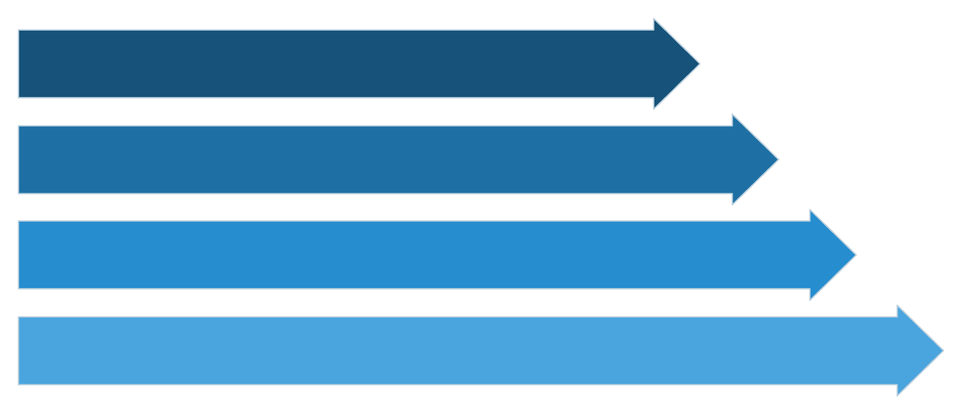
Business Analysis Methodologies: Waterfall
Requirements
Design
Implementation
Verification
The Waterfall model is a linear, sequential approach where each phase must be completed before the next begins. It's best suited for projects with well-defined requirements.
Key Principle: Strict adherence to a predefined plan.
BA Role: Defines comprehensive requirements upfront, ensuring thorough documentation.
Benefits: Clear structure, easy to manage, and ideal for stable projects.

Slide 28
Stakeholder Management
Effective stakeholder management is crucial for a BA's success. It involves identifying, analyzing, planning, and communicating with individuals or groups who can impact or be impacted by a project.
Identify Stakeholders
Analyze Needs & Expectations
Determine all individuals or groups involved, considering their influence and interest.
Understand their objectives, concerns, and potential impact on the project.
Plan Communication
Engage & Influence
Develop strategies to keep stakeholders informed and engaged throughout the project lifecycle.
Build strong relationships, manage conflicts, and gain consensus to drive project success.

Slide 29
Real-Life Example: E-commerce Website Redesign
Imagine a BA working on redesigning an e-commerce website for a retail company.
Problem: Low conversion rates on existing website, outdated design.
BA's Role:
Conducts user surveys and competitive analysis.
Gathers requirements from marketing, sales, and IT teams.
Creates wireframes and user stories for new features.
Collaborates with designers and developers.
Tests the new website and gathers feedback.

Slide 30








Benefits of a Business Analyst
Clarifies Vision
Improves Efficiency
Reduces Costs
Enhances Collaboration
Ensures a clear understanding of project goals and objectives.
Optimizes processes and workflows, leading to better resource utilization.
Identifies potential issues early, preventing expensive rework.
Facilitates better communication between all project participants.

Slide 31
Your Path to Becoming a Business Analyst
The Business Analyst role is dynamic and rewarding, offering a chance to drive meaningful change within organizations.
Start building your skills, understanding methodologies, and practicing stakeholder engagement. Your analytical mind can shape the future of business!

Slide 32

Data vs. Information: Understanding the Difference
This short course explains how raw data becomes meaningful information and, ultimately, actionable knowledge. We'll use simple definitions, business & IT examples, clear flow visuals, and exam‑friendly summaries.

Slide 33



What Is Data?
Definition
Forms
Data = raw, unprocessed facts and figures. They are discrete observations (numbers, words, timestamps, images, readings) captured without added meaning.
Examples: numeric values, text entries, timestamps, images, log lines, sensor outputs. Each is a standalone data point until contextualized.
Student Tip
Memorize: Data = inputs. Alone they are meaningless—e.g., "42", "Yes", or "Red" require context to become useful.

Slide 34



What Is Information?
Definition
Information = data that has been processed, structured, or presented with context so it becomes meaningful and answers specific questions.
How Data Becomes Information
Methods: sorting, aggregating, summarizing, labeling, visualizing, and applying business rules. These operations add context and reveal patterns.
Example
Raw temperature "42" + timestamp + location → "42°C at 2:00 PM in Server Room A" (information that can trigger action).
Real-world IT example: Raw web logs (data) → summarized traffic report showing daily active users, peak hours, and referral sources (information used by marketing).

Slide 35

Transformation Process: Data → Information → Knowledge
Data
Information
Knowledge
Data (Input)
Information (Process)
Knowledge (Output)
Collected facts: logs, measurements, transactions. Example: raw sales rows.
Organized outputs: reports, dashboards, alerts. Example: monthly sales summary by product.
Contextual insights: trends, forecasts, best practices. Example: reorder rules, promotional strategies.

Slide 36
Real-World Example: Retail Business (Concrete)
Data
Information → Knowledge
- Transaction rows: item ID, time, quantity, price, customer ID. - Sensor & inventory counts. - Customer clicks on the online store.
- Information: Weekly sales by SKU and region; peak shopping hours table; cart‑abandonment rates. - Knowledge: Stock top sellers before holidays, tailor promotions per region, optimize staffing for peak hours.
Exam practice question: Given raw transactions for a month, outline steps to produce a recommendation for next month's promotions. (Hint: clean data, aggregate by SKU, compute growth rates, identify top 10 by margin.)

Slide 37


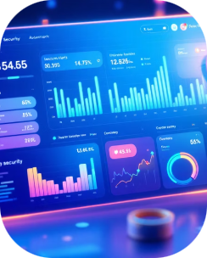
IT Example: Logs → Alerts → Policies
Data
Knowledge
Raw log entries: timestamps, IP addresses, event codes. Large volume, high velocity.
Actions: Update firewall rules, require MFA, schedule targeted audits — decisions guided by interpreted information.
Information
Filtered alerts: failed logins per hour, suspicious traffic spikes, correlated anomalies presented as dashboards.

Slide 38
Why Information Is Valuable for Decision Making
Reduces uncertainty
Enables comparison
Information provides evidence that narrows possible outcomes and clarifies risks.
Structured metrics let you compare alternatives (cost vs. benefit, region vs. region).
Improves speed & accuracy
Supports accountability
Processed information (dashboards, alerts) accelerates response times and reduces human error.
Transparent information creates traceable decisions and measurable outcomes.
Quick example: A marketing team uses conversion-rate information to decide whether to scale an ad campaign; the decision is faster and less risky than guessing from raw click logs.

Slide 39

Your Next Step: Think Like a Data Detective
1
Ask the right question
Start by defining what you need to know. This determines which data to collect and how to process it.
2
Process carefully
Clean, label, and aggregate data. Use visualizations to turn numbers into information.
3
Interpret with context
Combine information with domain knowledge to form actionable recommendations.
4
Practice with examples
Convert raw datasets into reports, then write short conclusions: that practice
helps you excel in exams and real projects.
Final exam checklist: Define data sources, show one processing step (e.g., aggregation), produce a simple chart or table as information, and state the resulting decision (knowledge). Good luck!

Slide 40
Overview of Data-Driven Decision Making
In today's fast-paced world, making informed decisions is more critical than ever. Data-Driven Decision Making (DDDM) is a methodology that empowers individuals and organizations to make strategic choices based on factual insights derived from data, rather than intuition or guesswork. This presentation will guide you through the core principles, benefits, processes, and common challenges of DDDM, preparing you to leverage data effectively in your academic and professional pursuits.

Slide 41




What is Data-Driven Decision Making?
Data-Driven Decision Making (DDDM) is an organizational approach to making strategic business decisions based on objective data rather than subjective observations or intuition. It involves collecting, analyzing, and interpreting data to gain actionable insights that support various aspects of an organization, from product development and marketing to operational efficiency and customer service.
Informed Choices
Objective Insights
Moves beyond gut feelings, relying on concrete evidence to shape strategies.
Uncovers hidden patterns and correlations in data, revealing opportunities or risks.
Strategic Alignment
Enhanced Performance
Ensures decisions are aligned with organizational goals, driving measurable outcomes.
Leads to better resource allocation, improved efficiency, and increased profitability.

Slide 42
Core Principles of Data-Driven Decision Making
Effective DDDM isn't just about having data; it's about adopting a mindset guided by several key principles. These principles ensure that data is used responsibly and effectively to foster growth and innovation.
1
2
3
Accuracy & Reliability
Relevance
Accessibility
Decisions are only as good as the data they're based on. Ensure data sources are credible and data collection methods are robust to maintain accuracy and reliability.
Focus on data that directly addresses the problem or question at hand. Irrelevant data can lead to distractions and skewed interpretations.
Data should be readily available to those who need it, in an understandable format. Tools and training can help democratize data access across an organization.
4
5
Actionability
Continuous Improvement
The ultimate goal of data analysis is to generate insights that can be acted upon. If data doesn't lead to a clear course of action, its value is diminished.
DDDM is an iterative process. Regularly review data processes, decision outcomes, and adjust strategies to foster a culture of ongoing learning and optimization.

Slide 43





Benefits of Using Data for Decisions
Embracing a data-driven approach unlocks a multitude of benefits, transforming how organizations operate and innovate.
These advantages extend from improving daily operations to shaping long-term strategic visions.
Enhanced Customer Understanding
Data provides deep insights into customer behaviors, preferences, and needs, allowing for
personalized experiences and improved satisfaction.
Optimized Operations
By analyzing operational data, organizations can identify bottlenecks, reduce waste, and
streamline processes, leading to greater efficiency.
Improved Risk Management
Data analytics can help predict potential risks, such as market shifts or supply chain disruptions,
enabling proactive mitigation strategies.
Competitive Advantage
Organizations that effectively leverage data can gain a significant edge over competitors,
identifying market trends and innovating faster.
Increased Revenue & Profitability
Better decisions in areas like pricing, marketing, and product development directly contribute
to higher sales and stronger financial performance.

Slide 44
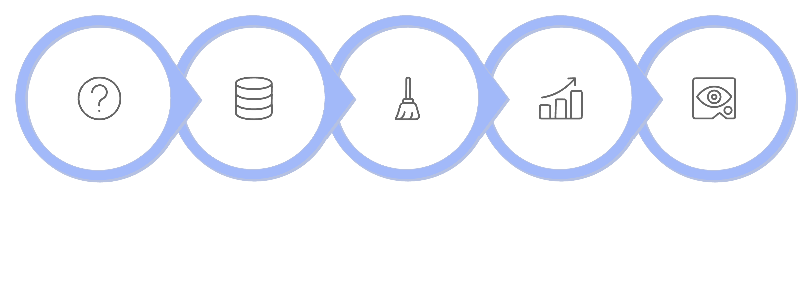





Steps in the Data-Driven Decision Process
The journey from raw data to actionable decisions typically follows a structured, iterative process. Understanding these steps is
crucial for anyone looking to implement DDDM effectively.
Define Question
Clean & Organize
Interpret & Visualize
Collect Data
Analyze Data

Slide 45
Step 1: Define the Question
Every data-driven decision begins with a clear, well-defined question or problem statement. Without a precise objective, data collection and analysis can become unfocused and yield irrelevant results.
Specificity is Key: Instead of "How can we improve sales?", ask "What specific features in our new product correlate with a higher conversion rate among first-time buyers?"
Measurable Goals: Ensure the question leads to outcomes that can be quantified and measured.
Stakeholder Alignment: Involve relevant stakeholders to ensure the question addresses a real business need and that everyone agrees on what success looks like.
A well-defined question acts as a compass, guiding the entire DDDM process towards meaningful insights and impactful decisions.

Slide 46
Step 2 & 3: Collect, Clean, and Organize Data
Once the question is defined, the next critical phase involves gathering the necessary data and preparing it for analysis. This is often the most time-consuming part of the process.
Data Collection
Data Cleaning & Organization
Source data from various channels such as databases, surveys, web analytics, social media, and transactional records. The method of collection should align with the defined question.
Raw data is rarely perfect. It often contains errors, inconsistencies, duplicates, and missing values.
Cleaning and organizing this data is essential
to ensure accuracy in analysis.
Internal databases (CRM, ERP)
Third-party market research
Customer feedback (surveys, interviews)
IoT sensors and device data
Remove duplicates and irrelevant data points.
Handle missing values through imputation or removal.
Correct errors and inconsistencies (e.g., spelling, formats).
Standardize data formats for uniformity.
A robust data foundation is paramount; flawed data will inevitably lead to flawed insights and decisions.

Slide 47
Step 4 & 5: Analyze Data, Interpret & Visualize
With clean, organized data, the next steps involve extracting insights and communicating them effectively. This transforms raw numbers into meaningful information.
01
02
Data Analysis
Interpretation & Visualization
Apply statistical methods, machine learning algorithms, or simple pattern recognition to uncover trends, correlations, and anomalies within the data. This phase answers the defined question.
Translate complex analytical findings into understandable insights. Data visualization plays a crucial role here, making trends and patterns evident to a wider audience.
Descriptive analysis (what happened?)
Diagnostic analysis (why did it happen?)
Predictive analysis (what will happen?)
Prescriptive analysis (what should we do?)
Create dashboards and reports.
Use charts (bar, line, pie), graphs, and maps.
Highlight key findings and their implications.
Tell a compelling story with the data.
Effective analysis and visualization are the bridge between data and insight, making complex information accessible and actionable.

Slide 48

Step 6: Act and Evaluate
The final and most crucial step is to act on the derived insights and then rigorously evaluate the outcomes. This completes the data-driven cycle.
Act
Evaluate
Implement the decisions based on the data analysis. This could involve launching a new product, optimizing a marketing campaign, or revising an internal process.
Monitor the impact of your actions by continuously collecting and analyzing new data. This evaluation determines whether the decision achieved its intended outcome.
Develop a clear action plan.
Allocate necessary resources.
Communicate changes to relevant teams.
Track key performance indicators (KPIs).
Compare results against initial goals.
Identify areas for further improvement.

Slide 49


Challenges and Pitfalls in Data-Driven Approaches
While DDDM offers immense advantages, it's not without its obstacles. Awareness of these challenges is the first step
toward mitigating them and ensuring a more successful data journey.
Data Overload & Noise
Lack of Data Quality
Confirmation Bias
Too much data can be as detrimental as too little, leading to "analysis paralysis" or focusing on irrelevant metrics. It's essential to define what data truly matters.
Inaccurate, incomplete, or inconsistent data can lead to flawed insights and poor decisions. Ensuring data integrity is a continuous effort.
The tendency to seek out, interpret, and remember information in a way that confirms one's preconceived notions can skew data interpretation.
Misinterpretation of Causation vs. Correlation
Resistance to Change
A common pitfall where a correlation between two variables is mistaken for a causal relationship. Understanding the difference is crucial for accurate conclusions.
Even with compelling data, organizational inertia or a preference for traditional, intuitive decision-making can hinder the adoption of data-driven strategies.

Slide 50
Case Discussions / Real-Life Examples
Understanding how concepts apply in real business situations
Learning through practical examples and case studies
Improving decision-making and problem-solving skills
A. Analysis of Business Scenarios
Identify the problem and objectives
Analyze available data and constraints
Evaluate possible solutions
Choose the best action plan

Slide 51
Example 1: Retail Store Sales Drop
Problem: Monthly sales decreased by 20%
Possible causes: Low footfall, high prices, poor promotions
Analysis: Compare sales data, customer feedback
Action: Improve offers and marketing strategy
Example 2: Manufacturing Delay
Problem: Orders delayed due to raw material shortage
Possible causes: Supplier issues, poor inventory planning
Analysis: Review supply chain and inventory levels
Action: Add backup suppliers and reorder levels

Slide 52
Introduction to Data Governance
Defining Data Governance
Key Components
Why It Matters
Data governance establishes the policies, procedures, roles, and responsibilities for managing data as a critical asset. It ensures data quality, security, and accessibility.
Data Quality Management
Data Security & Privacy
Data Architecture & Integration
Data Lifecycle Management
Effective data governance leads to better decision-making, reduced risks, improved compliance, and enhanced operational efficiency across the organization.

Slide 53




Understanding Data Ethics
Privacy
Confidentiality
Protecting personal information and ensuring individuals control their data. This includes anonymization and consent.
Safeguarding sensitive data from unauthorized access or disclosure, often through robust security measures.
Transparency
Accountability
Being open about how data is collected, used, and shared, fostering trust with data subjects.
Establishing clear responsibility for data handling practices and their ethical implications.

Slide 54
Regulatory Compliance: Global Standards
GDPR (General Data Protection Regulation)
CCPA (California Consumer Privacy Act)
A landmark privacy law by the European Union, GDPR sets strict rules for how personal data is collected, stored, and processed for EU citizens.
Providing California consumers with enhanced privacy rights and consumer protection, including the right to know and delete personal information.
Consent requirements
Right to be forgotten
Data breach notification
Right to access data
Right to opt-out of sales
Non-discrimination clauses

Slide 55
Building a Culture of Responsible Data Use
01
02
Educate & Train
Establish Clear Policies
Regular training programs for all employees on data privacy, security protocols, and ethical guidelines.
Develop and communicate comprehensive data governance policies that are easy to understand and enforce.
03
04
Promote Transparency
Lead by Example
Foster an environment where employees understand the 'why' behind data handling rules and ethical considerations.
Leadership must actively demonstrate commitment to ethical data practices, setting the tone for the entire organization.

Slide 56
CASE STUDY
Real-Life Example: Marketing
Real-Life Example: Finance
Scenario: Personalized Ads
Scenario: Loan Application
A bank uses AI algorithms to assess creditworthiness based on a vast array of customer financial data.
A marketing company uses customer browsing history and purchase data to deliver highly targeted advertisements.
Ethical Dilemma: Ensuring fairness and preventing algorithmic bias that could lead to unfair loan denials for certain demographics.
Governance Role: Establishing data quality standards for input data, model transparency, and regular bias testing of AI algorithms.
Ethical Resolution: Diverse training data, human oversight in decision-making, and clear appeals processes for applicants.
Ethical Dilemma: Balancing personalization with user privacy concerns and avoiding discriminatory targeting.
Governance Role: Implementing strict data minimization, anonymization, and opt-out mechanisms for targeted ads.
Ethical Resolution: Providing clear consent options, transparent data usage policies, and regular audits to prevent bias.

Slide 57

Real-Life Example: IT Operations
Scenario: Data Breach Response
Scenario: Health Data Sharing
A company experiences a cyberattack resulting in the exposure of customer personal data.
A healthcare provider shares anonymized patient data with research institutions for medical advancements.
Ethical Dilemma: The speed and transparency of disclosure versus potential reputational damage and legal consequences.
Governance Role: Implementing robust incident response plans, data backup and recovery, and clear communication protocols for breaches.
Ethical Resolution: Prompt notification to affected individuals and authorities, offering support (e.g., credit monitoring), and learning from the incident to strengthen defenses.
Ethical Dilemma: Ensuring data is truly anonymized and preventing re-identification, while maximizing its benefit for public health research.
Governance Role: Strict data de-identification processes, data sharing agreements, and ethical review board oversight.
Ethical Resolution: Obtaining explicit consent for data sharing, robust technical safeguards, and continuous monitoring for potential privacy risks.

Slide 58





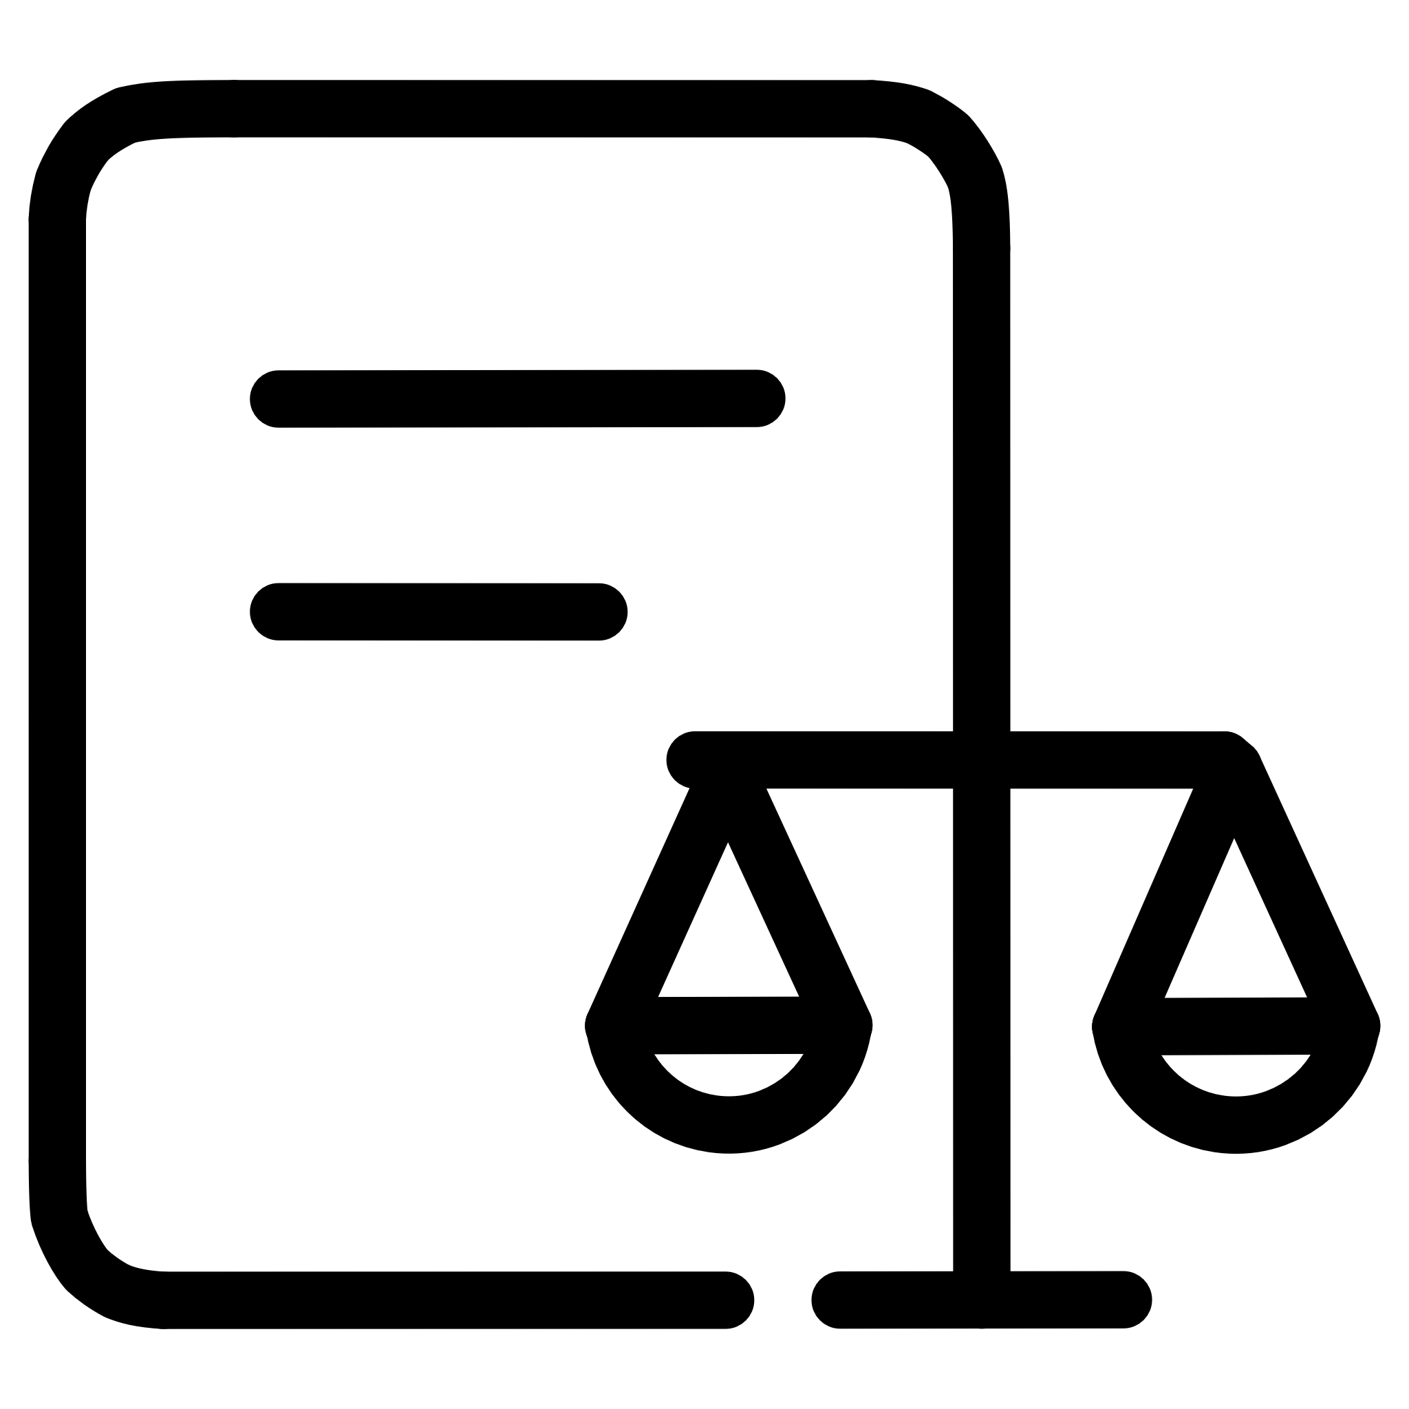
Key Takeaways
Data Governance
Ensures clear structure and ownership
Data Ethics
Guides fair and responsible use
Regulatory Compliance
Provides legal and procedural framework
Structure
Morality
Framework

Slide 59
Conclusion :
Information Technology plays a vital role in modern business systems.
Understanding data types, sources, and life cycle helps manage information effectively.
Business Analysts bridge the gap between business needs and IT solutions.
Converting data into meaningful information supports better understanding.
Data-driven decision making improves accuracy and reduces risks.
Real-life applications show how data improves business performance.
Data Governance and Data Ethics ensure data is used responsibly, securely, and legally.

Slide 60
Thank You

